Slide 1

Oral Project Report Presentation: Anomaly Detection in an IoT Setting Slide 1: Title Slide
Title: Anomaly Detection in an IoT Setting: From Model to Production
Subtitle: Course: DLBDSMTP01 – Oral Project Report
Presented by: Abdoulie Drammeh
Intitutuion: International University of Applied Science
Email: abdouliedrammeh02@gamil.com
Date: 06/30/2025

Slide 2

Slide 2: Project Overview
Goal: Detect anomalies in real-time factory sensor data
Setting: Wind turbine factory with temperature, humidity, and sound sensors
Technology Stack:
Python, Scikit-learn, Flask
REST API, Stream simulation, Isolation Forest

Slide 3
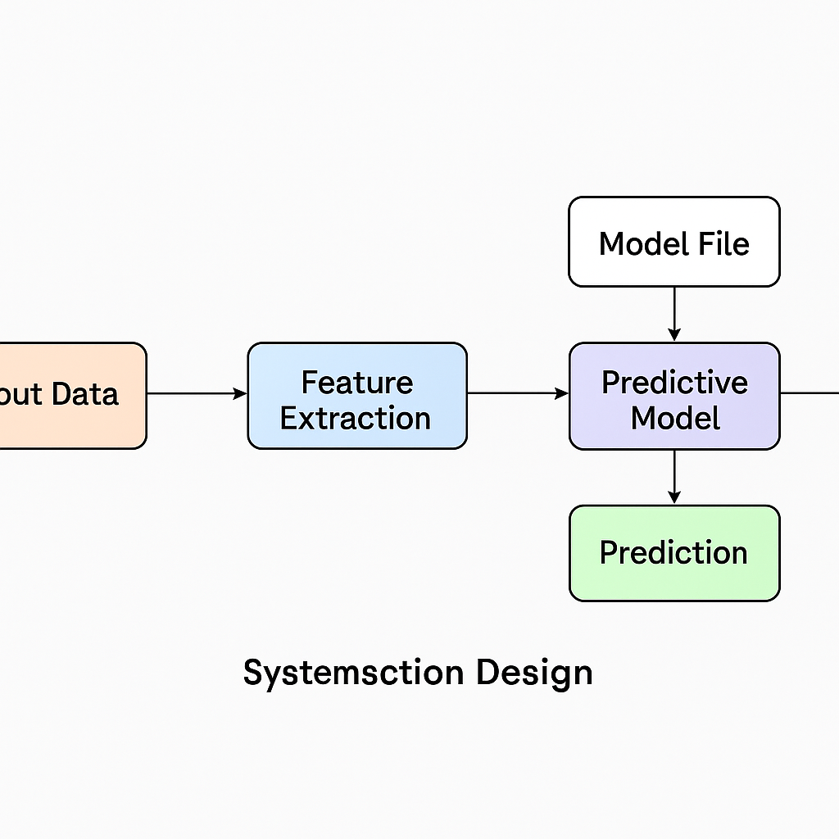
Slide 3: System Architecture Diagram
[Visual Placeholder: System flowchart showing]
IoT Sensors ➔
Data Ingestion API ➔
Preprocessing Layer ➔
Flask Model Server ➔
Prediction Output ➔
Logging & Storage ➔
Monitoring Dashboard (optional)

Slide 4
Slide 4: Data Simulation & Acquisition
Simulated data: 1,000 samples using a CSV
Sensor features: temperature, humidity, sound volume
Streaming approach:
Real-time simulation using Python and time.sleep()
Format: JSON POST requests to API

Slide 5
Slide 5: Model Training
Algorithm: Isolation Forest (unsupervised)
Preprocessing: StandardScaler from sklearn
Training details:
Lightweight, fast, requires no labels
Assumed 5% contamination (anomaly rate)
Output: Anomaly predictions and confidence scores

Slide 6
Slide 6: Model as a Service
Deployment tool: Flask REST API
Endpoint: /predict
Input format:{ "temperature": 70, "humidity": 60, "sound_volume": 90}
Response: { "anomaly": -1, "anomaly_score": -0.23}

Slide 7
Slide 7: Monitoring & Maintenance
Monitoring Components:
API health check endpoint
Input validation & error logs
Prediction logging
(Optional) Prometheus, Grafana integration
Maintainability:
Modular Flask app
Model/Scaler versioned with joblib

Slide 8
Slide 8: Challenges & Solutions
Challenge | Solution
Streaming simulation | Used Python + sleep() to simulate data
No real sensor data | Generated synthetic data in CSV
Real-time predictions | Flask API serving Isolation Forest model
Data format variation | Preprocessed with StandardScaler

Slide 9
Slide 9: Summary & Reflection
✅ Delivered a working end-to-end anomaly detection system
🔄 Designed for modularity and cloud-readiness
📦 Ready for real-time integration or dashboard extensions
🎯 Key learning: Bridging machine learning with API services

Slide 10
✅ Slide 10 (Q&A + GitHub Link)
🖼️ Slide Title:
Questions & Live Demo / Source Code
💬 Content:
“Thank you for your attention.”
“You can view or download the full application and code at:”
🔗 https://github.com/abdouliedrammeh/SENSORS
https://github.com/abdouliedrammeh/SENSORS/archive/refs/heads/main.zip

